Slide 1
Bus Reservation System
TEAM MEMBERS
10672462 Gunjan Lund
10672100 Dharmi Mehta
10672080 Juman Das
10672213 Ronak Parmar

Slide 2
Introduction​
Online bus reservation system is a project which provides an online portal for bus ticket reservation. ​
This application allows customers to book bus tickets from anywhere and anytime. ​
The customer can easily book and cancel their tickets at their comfort. The customer can view all the details of the seats, bus, and route. ​
The customer can also view and download the details of the journey and journey timings. ​
This will give customer an overview of the journey and will be a hassle-free task of doing bus​ reservation at fingertips. ​

Slide 3
Technologies Used
Database Management System: Microsoft SQL Server​
Web Api using Microsoft .NET Framework​
Angular 8 ​

Slide 4
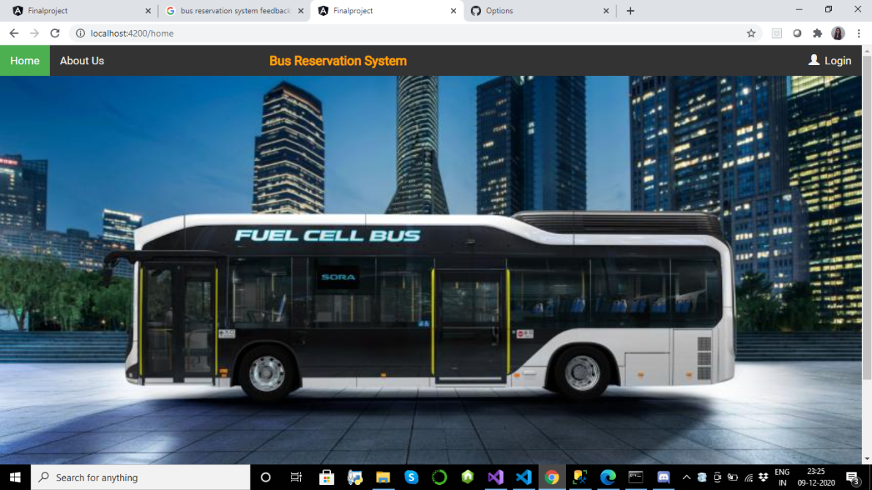
Home Page

Slide 5
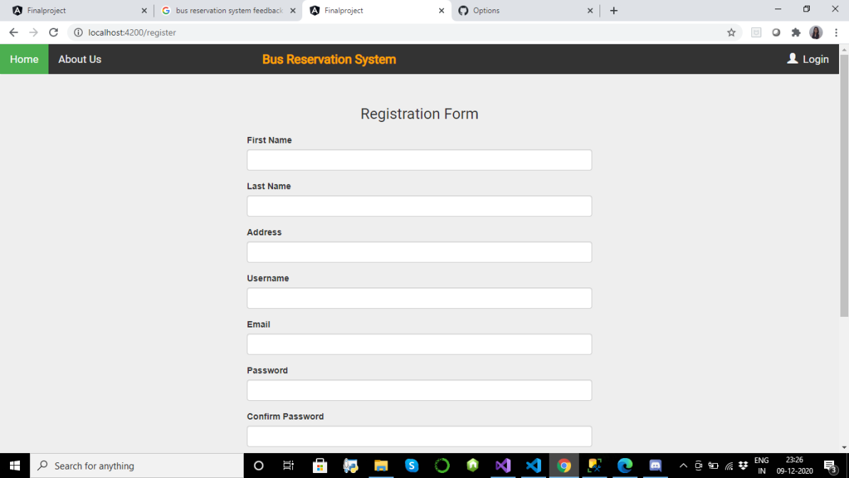
Registration Page

Slide 6
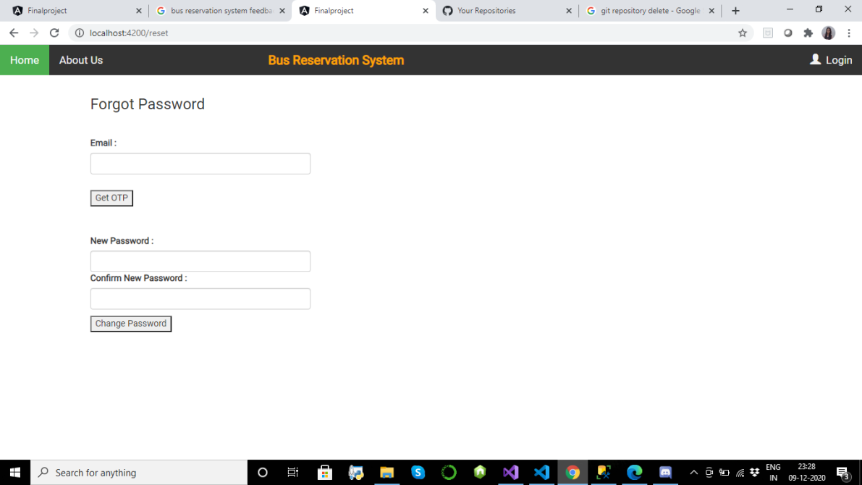
Reset Password Page​

Slide 7
Admin​
Functionality of Admin module is as follows:​
View all the buses in the system​
Add a new bus​
View all the booking details as per the entered time span​

Slide 8
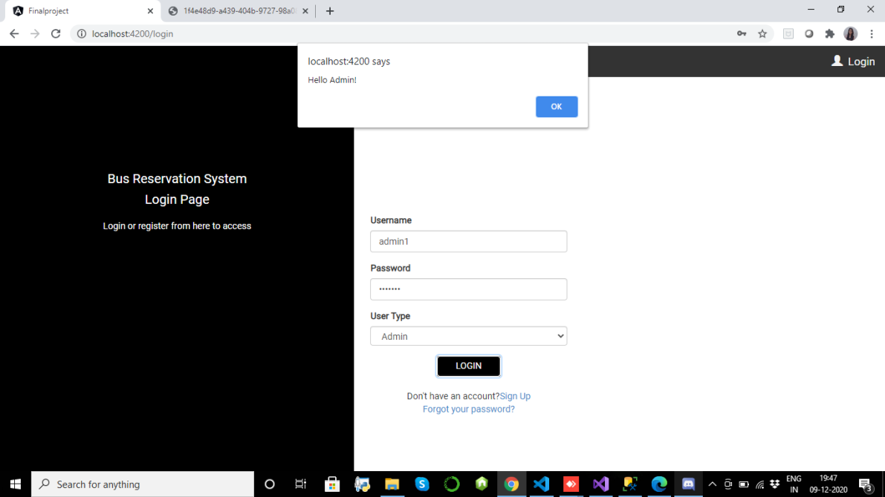
Admin Login

Slide 9
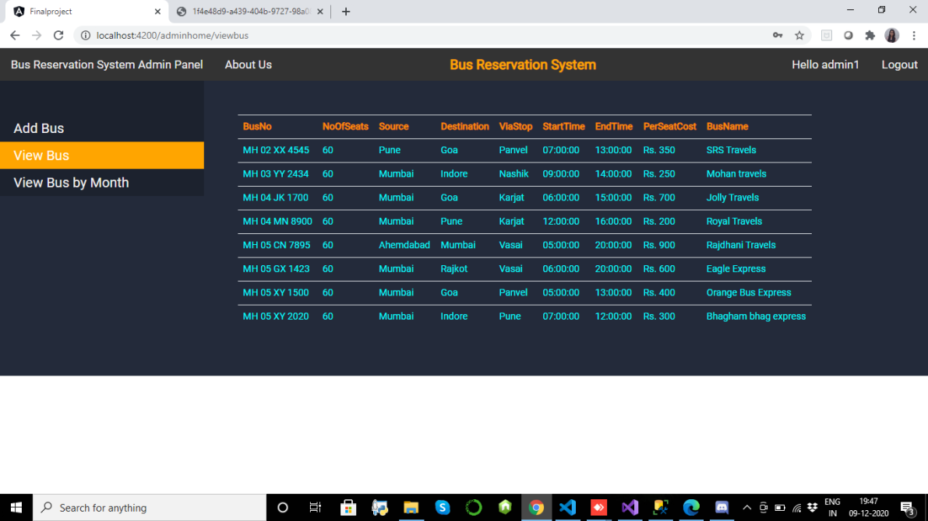
View Bus

Slide 10
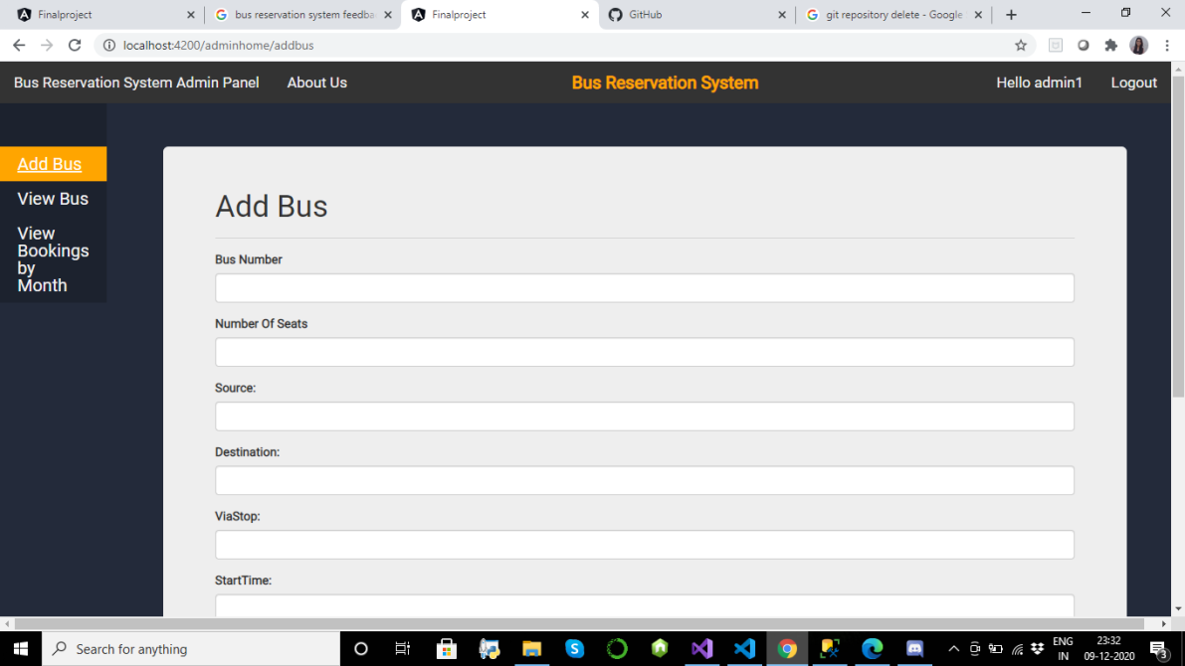
Add Bus

Slide 11
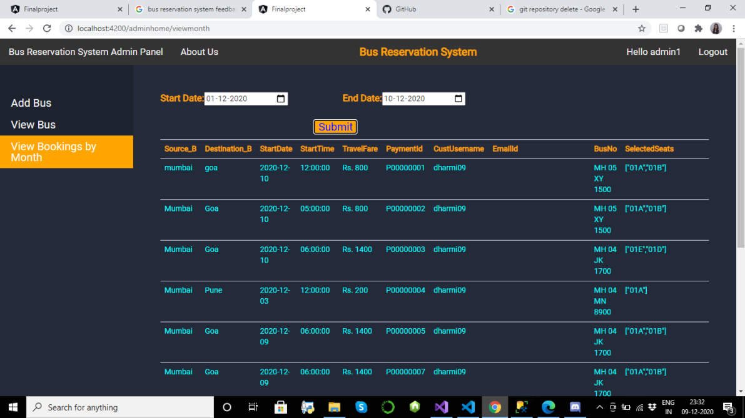
Bookings by month

Slide 12
Registered User​
Functionality for Registered User Module is as follows:​
Book bus tickets​
View and download bus tickets​
Can access User dashboard​
View all bookings​
Cancel bookings and get Refunds​
Change Password​
Update Wallet​

Slide 13
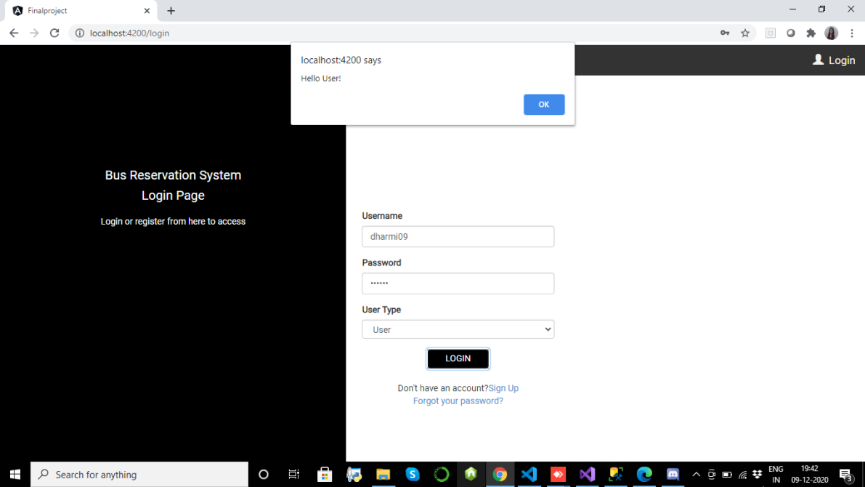
User Login

Slide 14
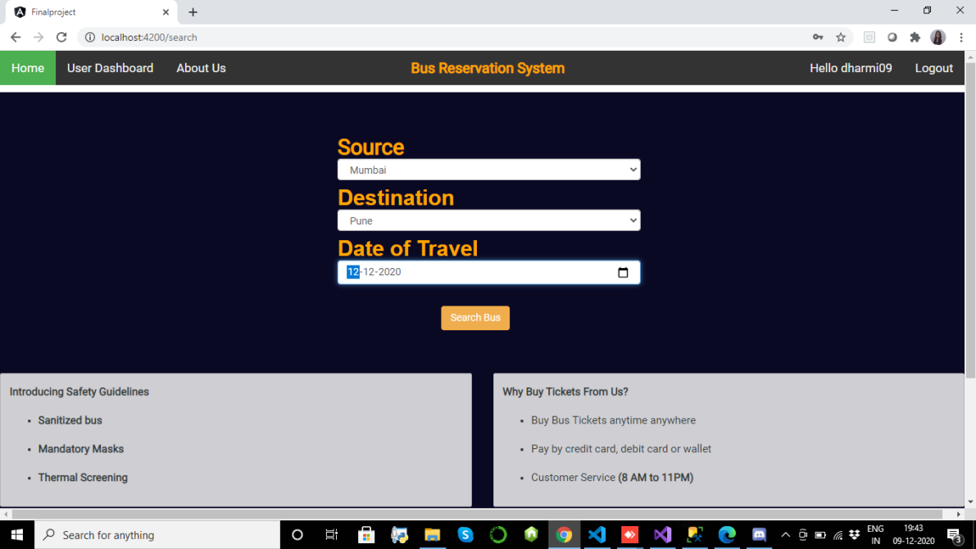
Search Bus Page​

Slide 15
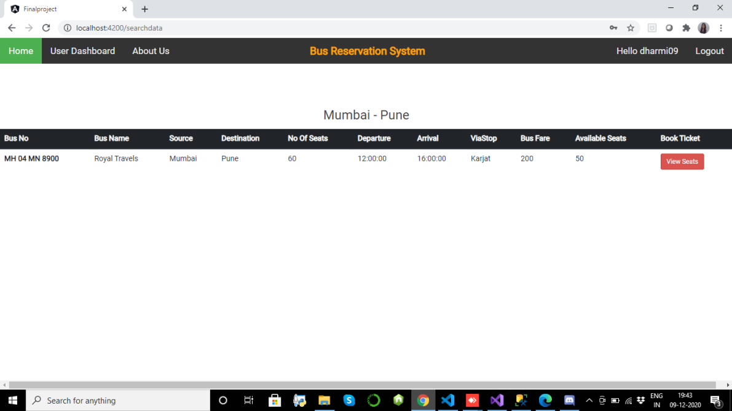
Select Bus Page

Slide 16
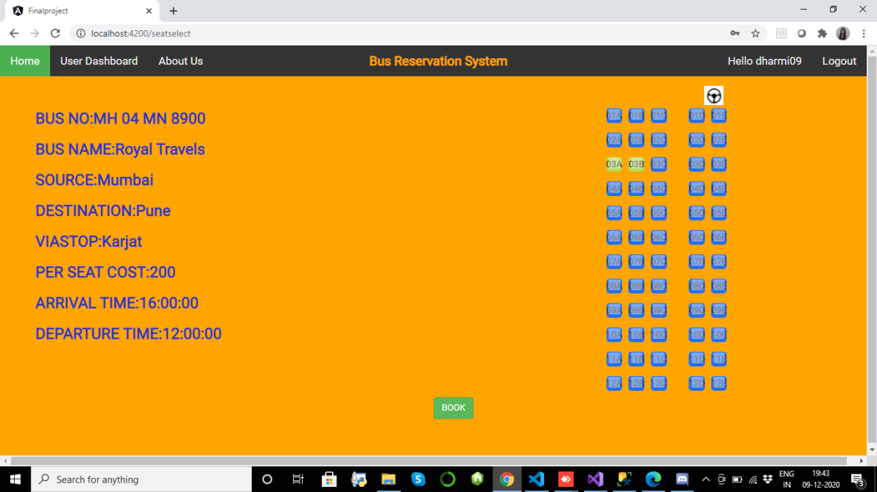
Seat Selection Page

Slide 17
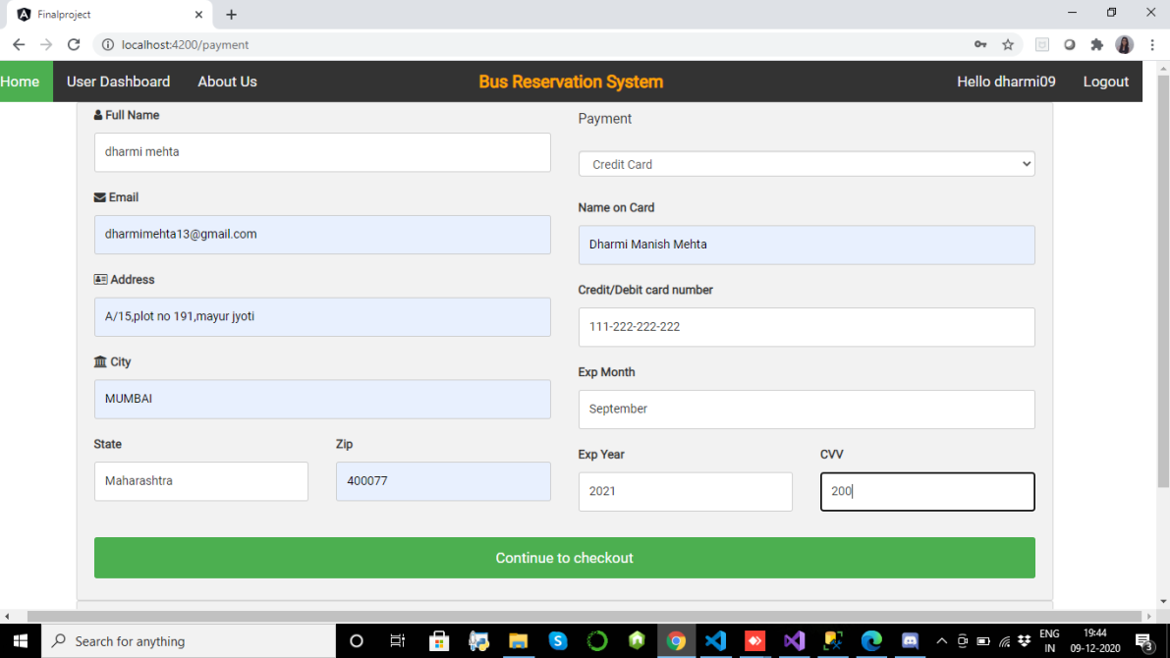
Payments Page​

Slide 18
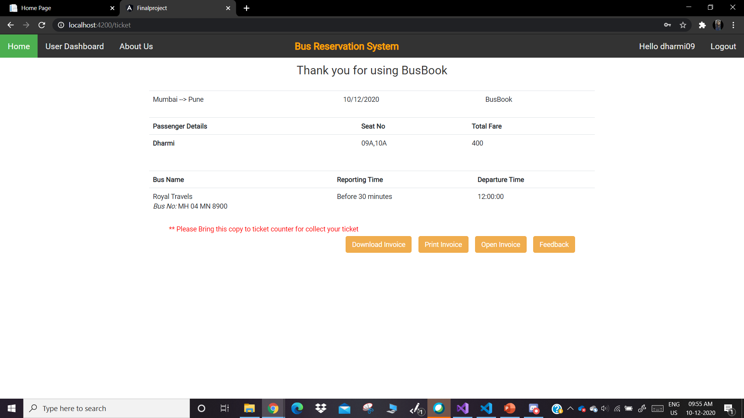
Ticket Page​

Slide 19
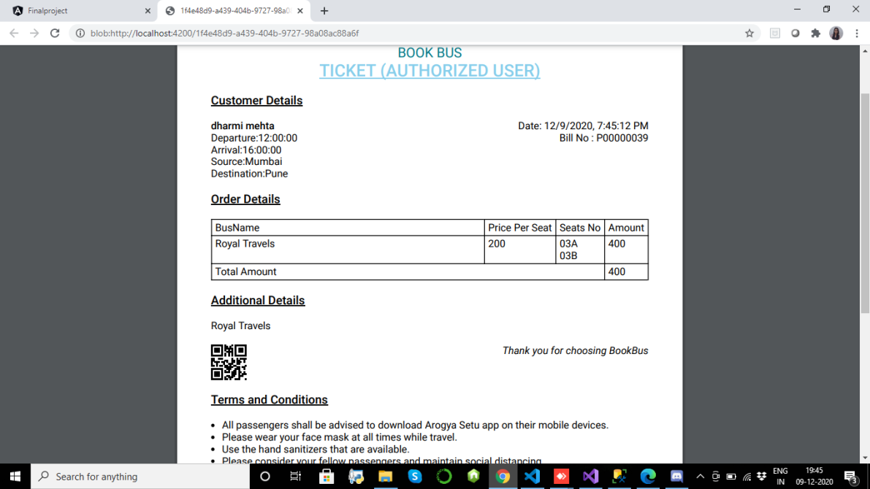
Downloaded Ticket

Slide 20
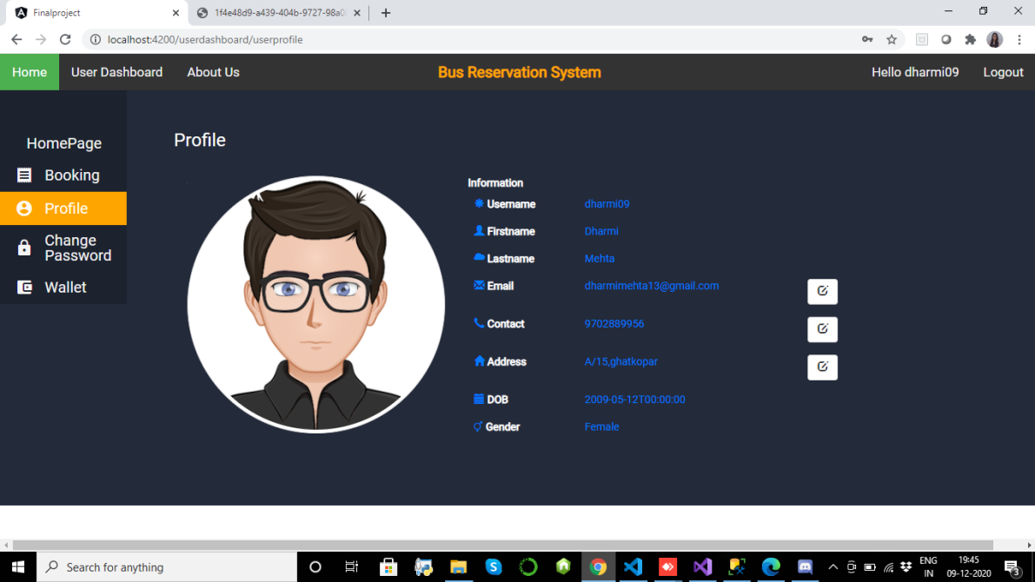
User Dashboard​

Slide 21
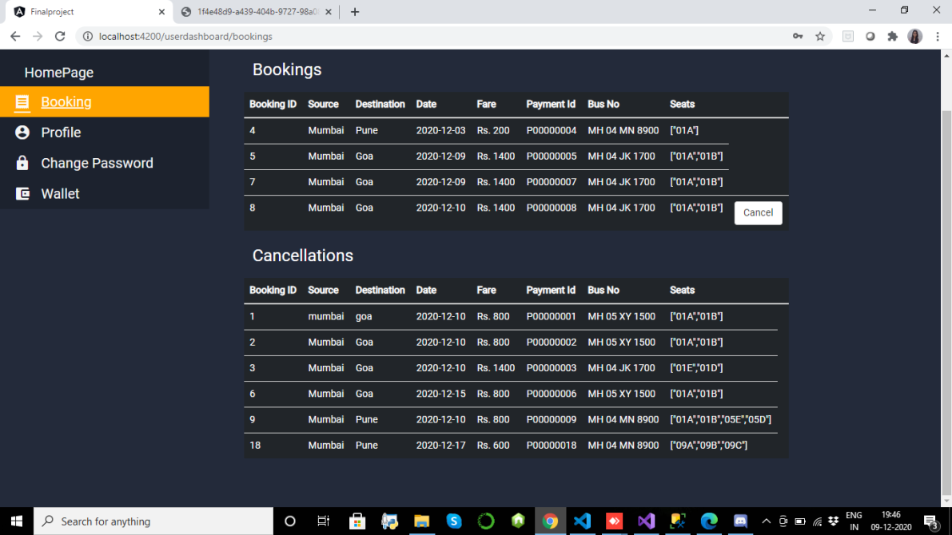
Bookings Page​

Slide 22
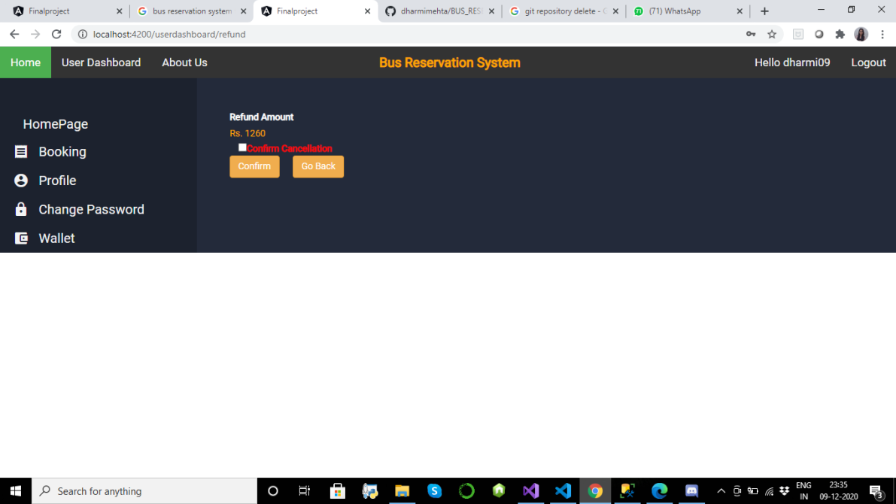
Cancellation Page​

Slide 23
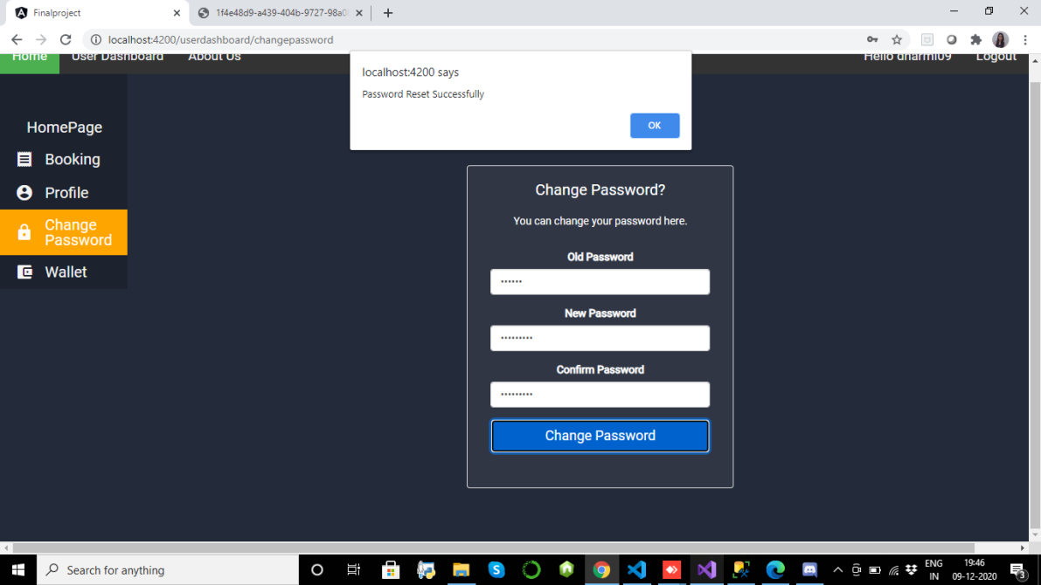
Change Password Page​

Slide 24
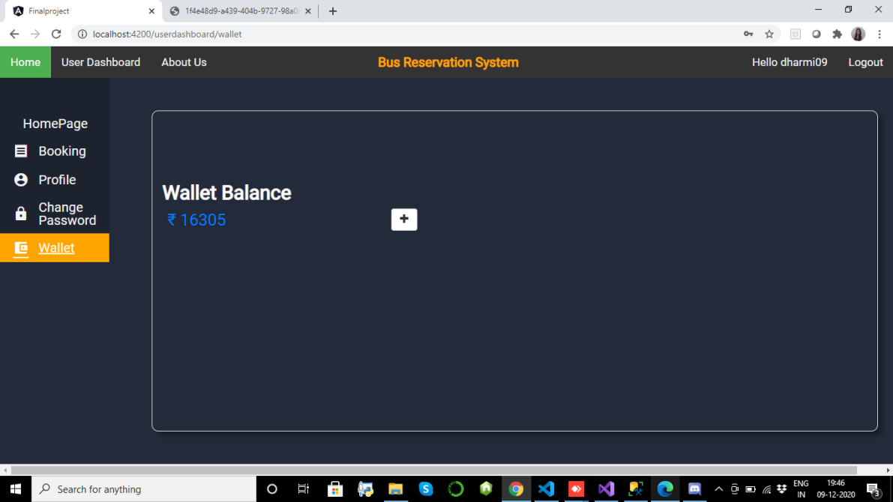
Wallet details Page​

Slide 25
Guest User​
Functionality for Guest User Module is as follows:​
Book bus tickets​
View bus ticket​
Download bus ticket​

Slide 26
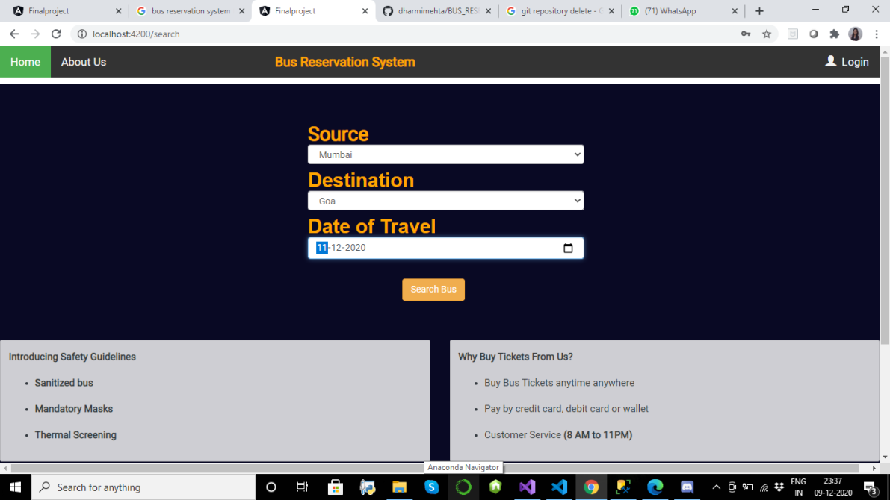
Search Bus Page​

Slide 27
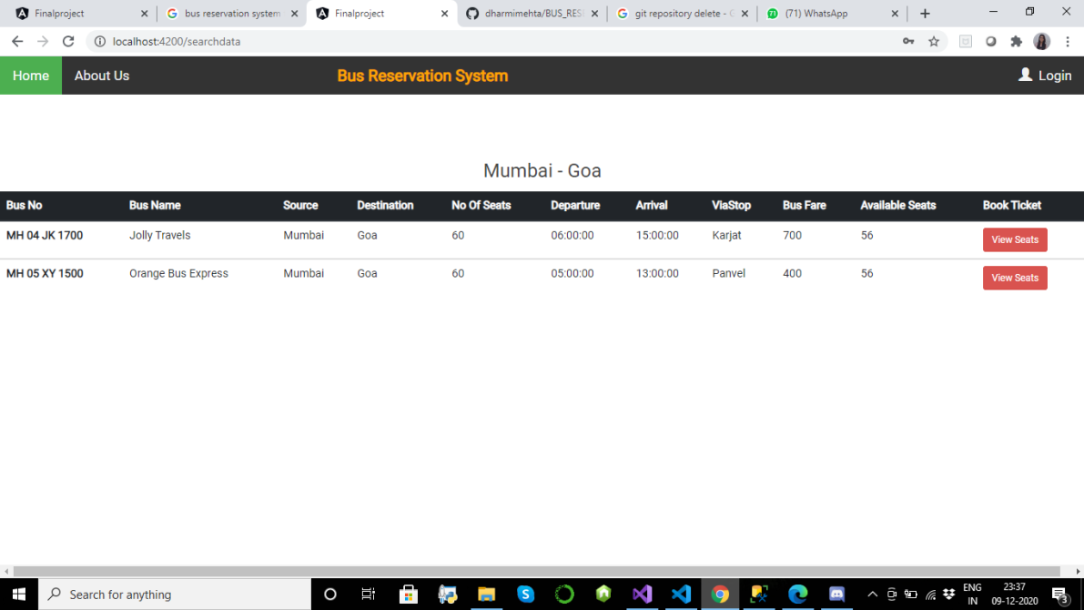
Select Bus Page​

Slide 28
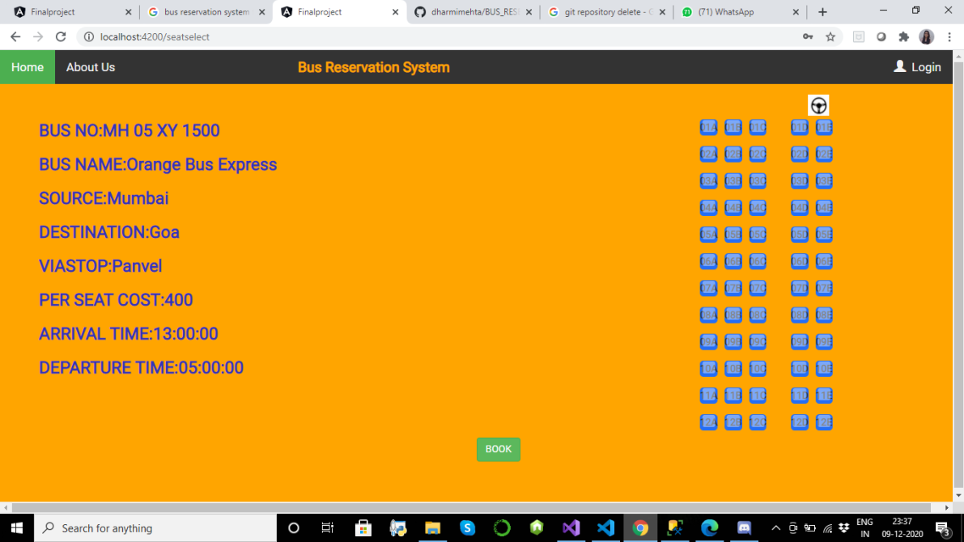
Seat Selection Page​

Slide 29
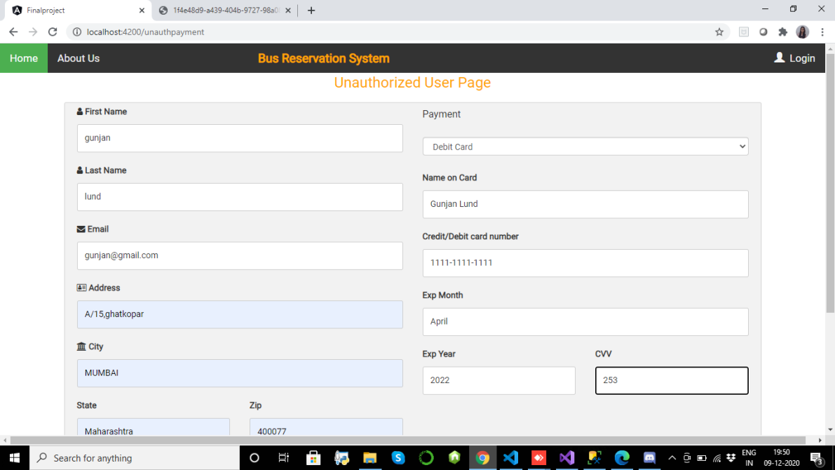
Payments Page​

Slide 30
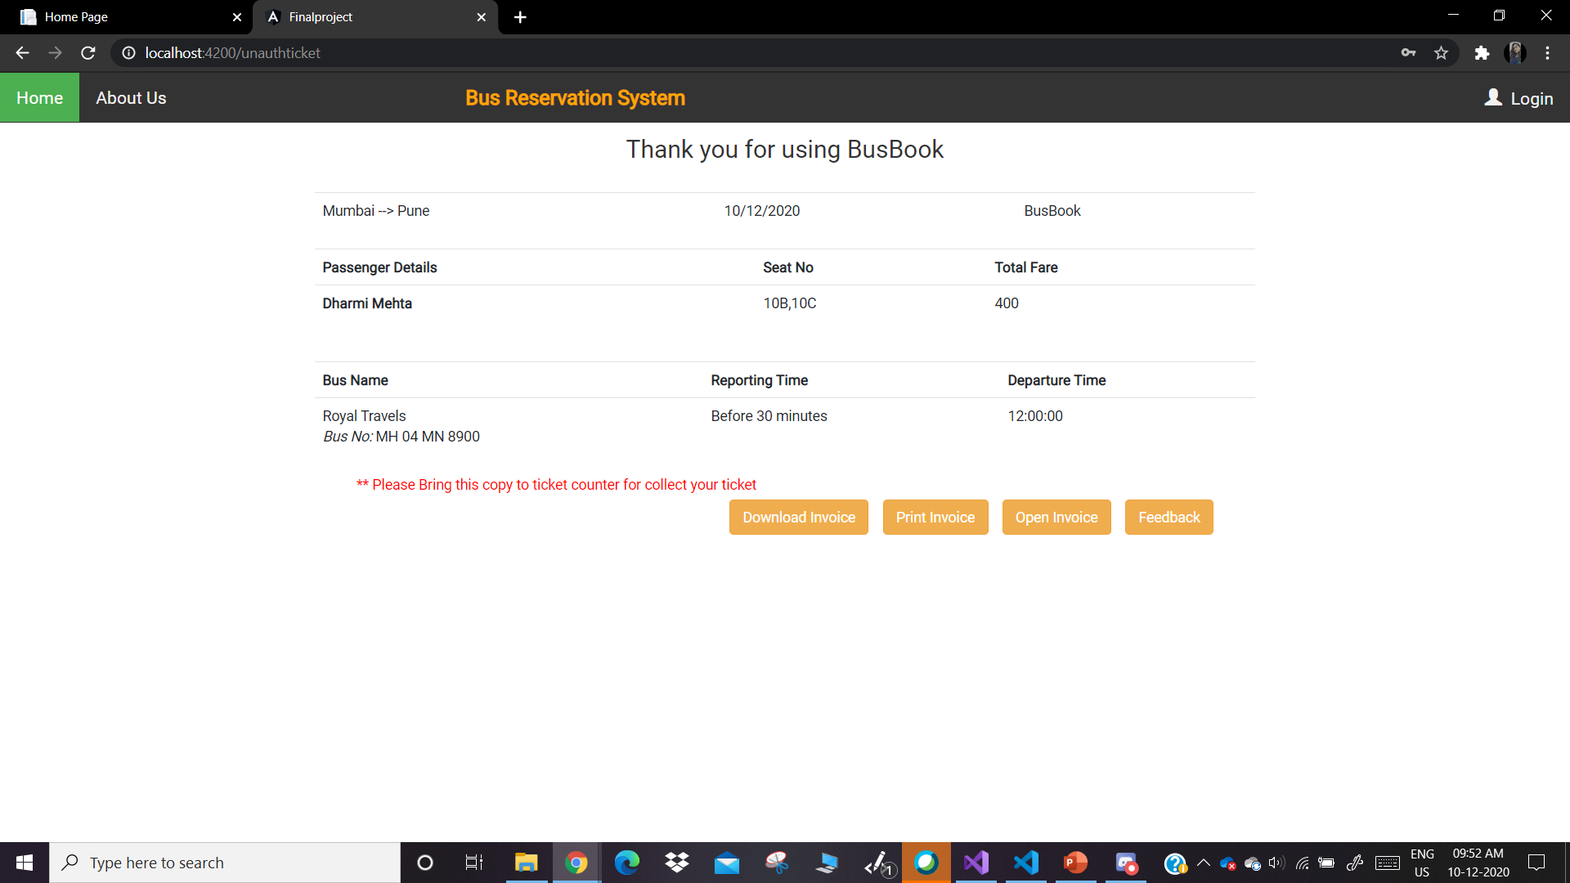
Ticket Page​

Slide 31
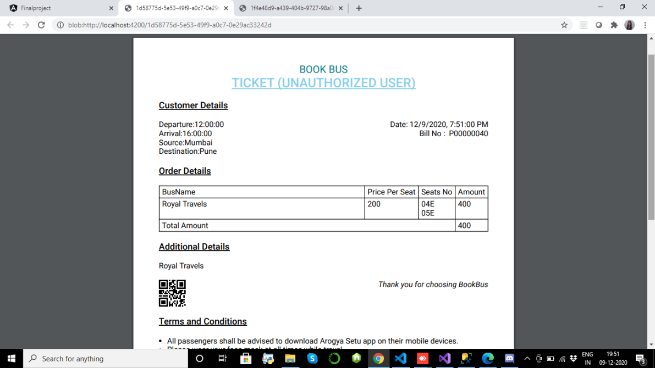
Downloaded Ticket

Slide 32
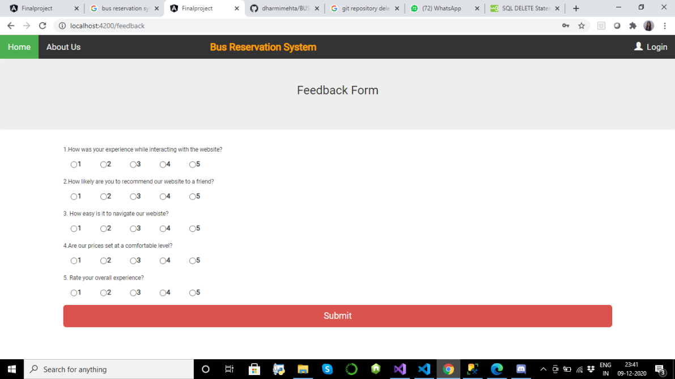
Feedback Page

Slide 33
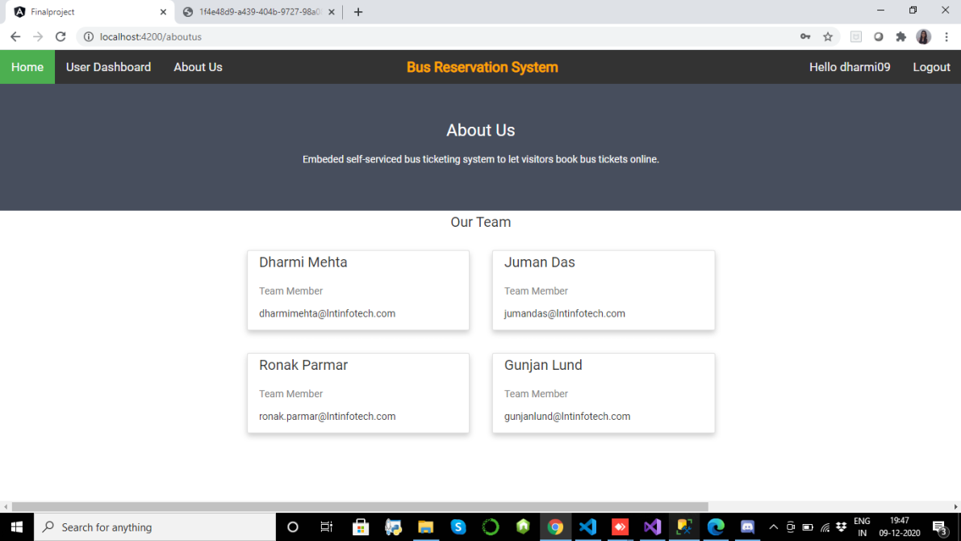
About Us Page​

Slide 34
THANK YOU!

